Slide 1

NLP-HOTEL REVIEWS

Slide 2
Project memebers
Under the guidelines
Advith
hareesh
Muddangula.Shirisha
Yenneti.Lekha Sree
Atike.Bhadralaxmi
Barla.Akshitha
Karavadi.Jaya Lakshmi
Dappu.Vaishnavi
Gorantla.Hema Latha

Slide 3
Content
Business Objective
EDA
Data Visualization
Data Preprocessing
Word Cloud
Feature Extraction
Model Building
Conclusion
Deployment & Dashboard
Problems Facing
How to overcome
Reference

Slide 4
Business Objective
The goal of this project is to build unsupervised Natural Language Processing (NLP) machine learning models that decide whether a text review is positive review or negative review. This project, will help hotels to determine the category of text review and cluster them automaticity to improve their services.

Slide 5
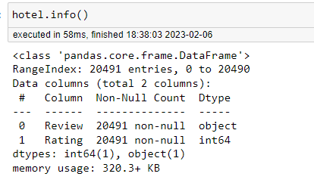
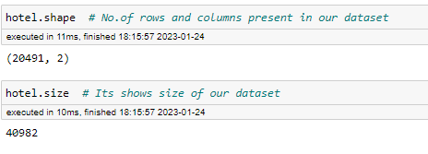
EDA
Exploratory data analysis (EDA) is an approach to analyzing and understanding a dataset. It generally includes visualizing the data, summarizing the main characteristics, and identifying patterns and relationships within the data.
EDA is typically the first step in the data analysis process, and it is an important way to gain insights and identify potential issues before building models or making predictions.

Slide 6
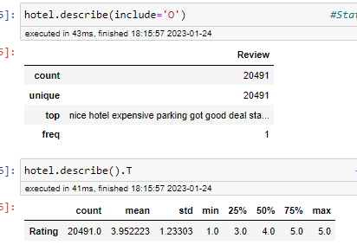
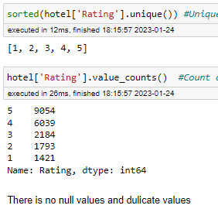
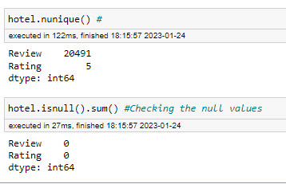
To find the null values in the data set ,null value present drop the null value or replace th null values
Check Duplicated values in the data set
In case present the duplicated values drop the duplicated values

Slide 7
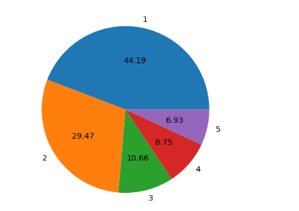
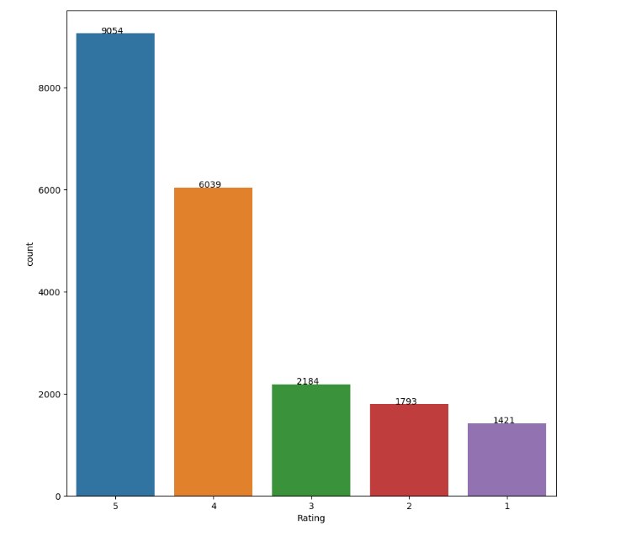
Data Visualization
A pie chart helps organize and show data as a percentage of a whole.
countplot() method is used to Show the counts of observations in each categorical bin using bars.

Slide 8
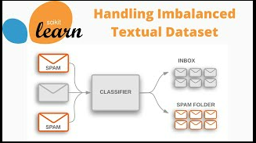
Data Pre-processing
The preprocessing steps for text data are different from the traditional data preprocessing for structured data. Some common NLP data preprocessing techniques include
Tokenization: Breaking down the text into individual words or phrases (tokens)
Stop-word removal: Removing common words like "a", "an", "the", etc. that do not carry meaning
Stemming or Lemmatization: Reducing words to their base form to reduce the dimensionality of the data
Removing punctuation and special characters
Lowercasing or uppercasing all text
Removing numbers
Removing whitespaces
Removing HTML tags
Replacing synonyms or words with similar meaning

Slide 9
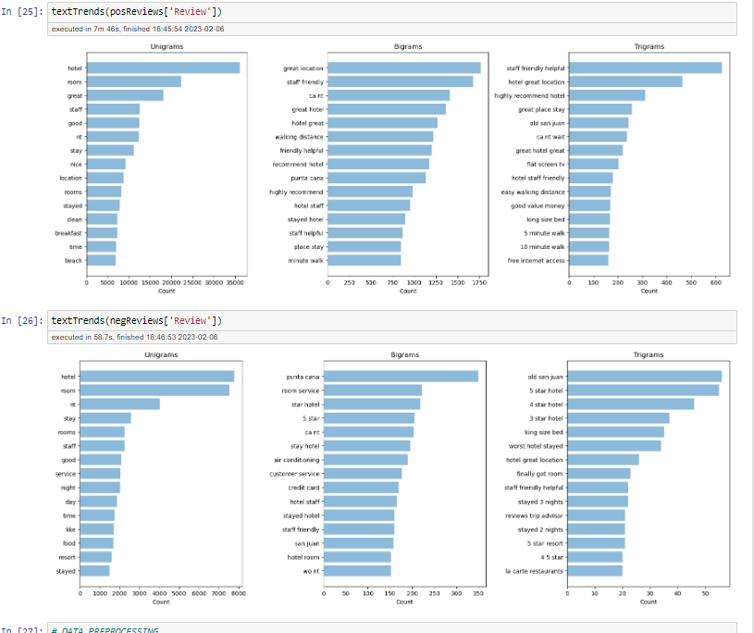
N-gram Analysis - Bigram and Trigram
Sentiment analysis of Bigram/Trigram :
N-grams analyses are often used to see which words often show up together. I often like to investigate combinations of two words or three words, i.e., Bigrams/Trigrams. An n-gram is a contiguous sequence of n items from a given sample of text or speech.

Slide 10
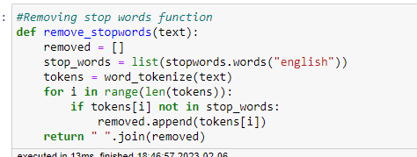
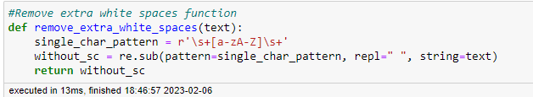

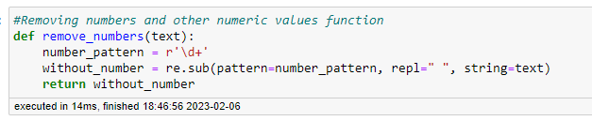
Removing STOP-WORDS , EXTRA WHITE-SPACE & PUNCTUATIONS
Stop word removal is one of the most commonly used preprocessing steps across different NLP applications.
The basic approach is to use the lstrip() function from the inbuilt python string library. The function lstrip() removes any unnecessary spaces .
One of the easiest ways to remove punctuation from a string in Python is to use the str. translate() method.
Python provides a regex module that has a built-in function sub() to remove numbers from the string. This method replaces all the occurrences of the given pattern in the string with a replacement string

Slide 11
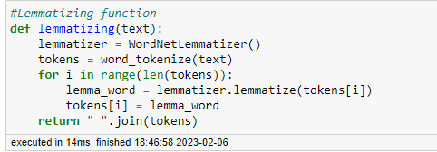
Lemmatization
Lemmatization is a text normalization technique used in Natural Language Processing (NLP), that switches any kind of a word to its base root mode. Lemmatization is responsible for grouping different inflected forms of words into the root form, having the same meaning.

Slide 12
Word Cloud
A word cloud, also known as a tag cloud, is a data visualization technique used to display the most frequently occurring words in a text corpus.
The words are typically displayed in different sizes and font weights, with the most frequent words appearing larger and bolder than the less frequent words.
Word clouds are often used in text mining, content analysis, and sentiment analysis applications.

Slide 13
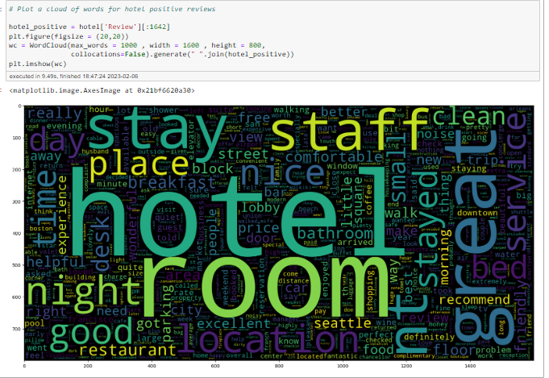
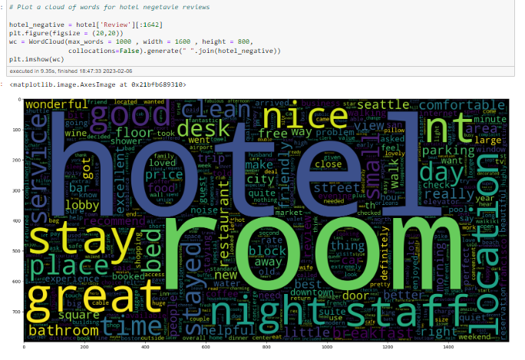
Positive & Negative reviews (Word Cloud)

Slide 14
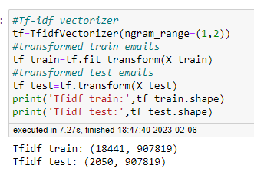
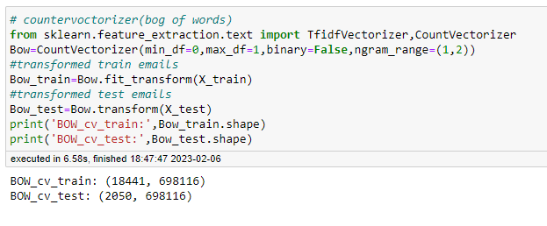
Feature extraction
In Natural Language Processing (NLP), feature extraction refers to the process of extracting relevant information from text data in order to represent it in a form that can be used by machine learning models. There are several common feature extraction techniques used in NLP, such as
Some common feature extraction techniques for text data are:
Bag of Words
TF-IDF
Word2Vec
GloVe
BERT

Slide 15
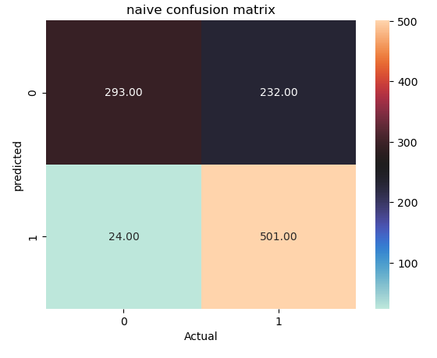
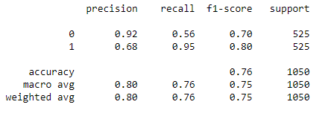
Naive Bayes model
Naive Bayes is a probabilistic algorithm that is based on Bayes' theorem. It is a simple yet powerful technique for classification tasks.
Naive Bayes assumes that all the features of the data are independent of each other, which is called class conditional independence. Naive Bayes algorithm is commonly used in text classification and spam filtering, it's also useful in problems where the number of features is greater than the number of observations.

Slide 16
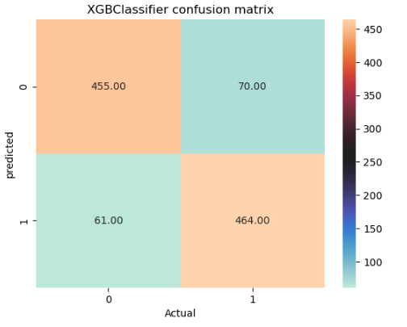
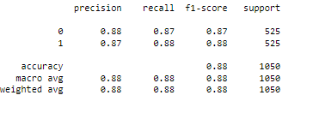
XG boostclassifier model
XGBoost (Extreme Gradient Boosting) is an optimized version of Gradient Boosting algorithm. It is an open-source library that is widely used for supervised learning, mainly for classification and regression problems. It was specifically designed to improve the computational efficiency and model performance of Gradient Boosting.
It was specifically designed to improve the computational efficiency and model performance of Gradient Boosting.

Slide 17
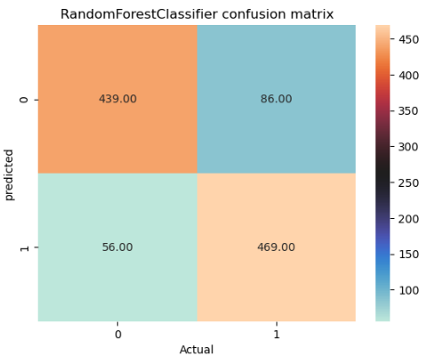
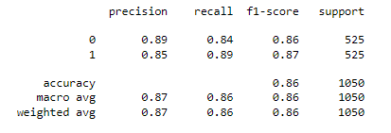
Randomforest classifier model
Random Forest is an ensemble learning method that uses multiple decision trees to make predictions.
It is a type of supervised learning algorithm, typically used for classification and regression tasks.
The basic idea behind Random Forest is to combine the predictions of multiple decision trees to reduce overfitting and improve the overall performance of the model.

Slide 18
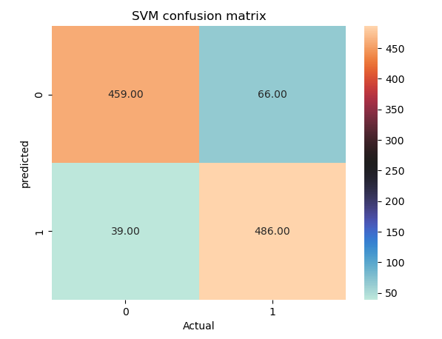
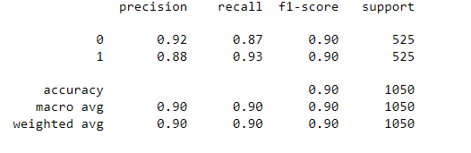
Support Vector Machine(SVM)
Support Vector Machine (SVM) is a supervised learning algorithm that can be used for classification or regression tasks. The idea behind SVM is to find the hyperplane in a high-dimensional space that maximally separates the different classes. The data points closest to the hyperplane are called support vectors and have the greatest impact on the position of the hyperplane.
SVM uses a technique called kernel trick to transform the data into a higher dimensional space where a linear hyperplane can be used for classification. It is particularly useful for problems where the number of dimensions is greater than the number of samples.

Slide 19
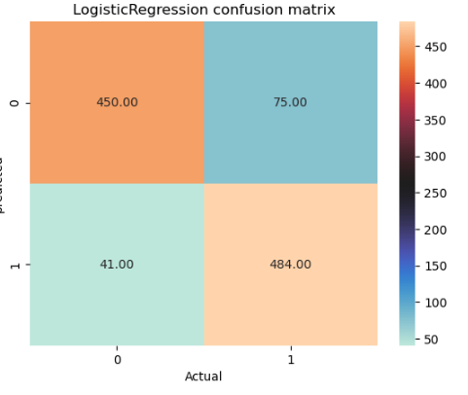
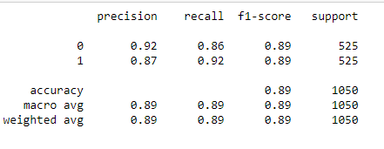
Logistic Regression
Logistic Regression is a statistical method used for binary classification problems, where the goal is to predict a binary outcome based on input features.
It uses a logistic function to model the probability of the target variable taking on a particular value and is trained using labeled data to find the optimal coefficients that maximize the likelihood of the observed data. It's simple, interpretable and has been widely used in many industries.

Slide 20
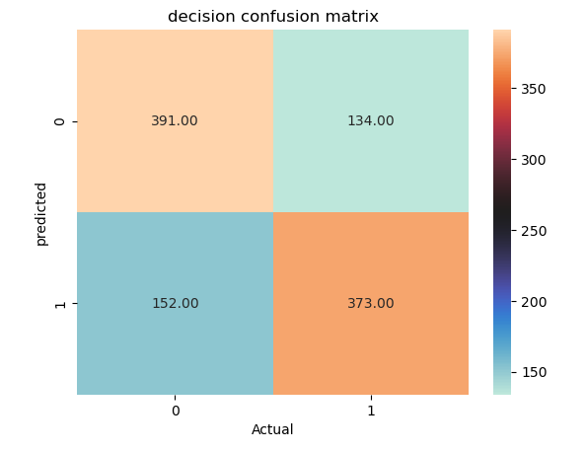
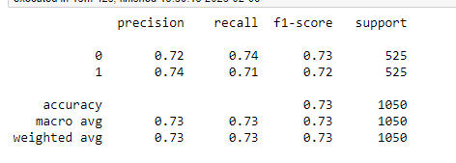
DecisionTreeClassifier Model
The main advantage of the decision tree classifier is its ability to using different feature subsets and decision rules at different stages of classification.
In a decision tree, for predicting the class of the given dataset, the algorithm starts from the root node of the tree. This algorithm compares the values of root attribute with the record (real dataset) attribute and, based on the comparison, follows the branch and jumps to the next node.

Slide 21
Conclusion:
When comparing the accuracy of different models, the model with the highest accuracy is usually a good choice for deployment. However, it's important to consider other evaluation metrics, such as F1-score, precision, and confusion matrix, as they provide a more complete picture of the model's performance.
If two models have similar accuracy, the one with the higher F1-score is often a better choice, as it takes into account both precision and recall and provides a better overall picture of the model's performance. Additionally, you should examine the confusion matrix to ensure that the model is making appropriate predictions for all classes in the dataset. Ultimately, the best model for deployment will depend on the specific use case and the desired trade-off between accuracy, precision, recall, and other factors.

Slide 22
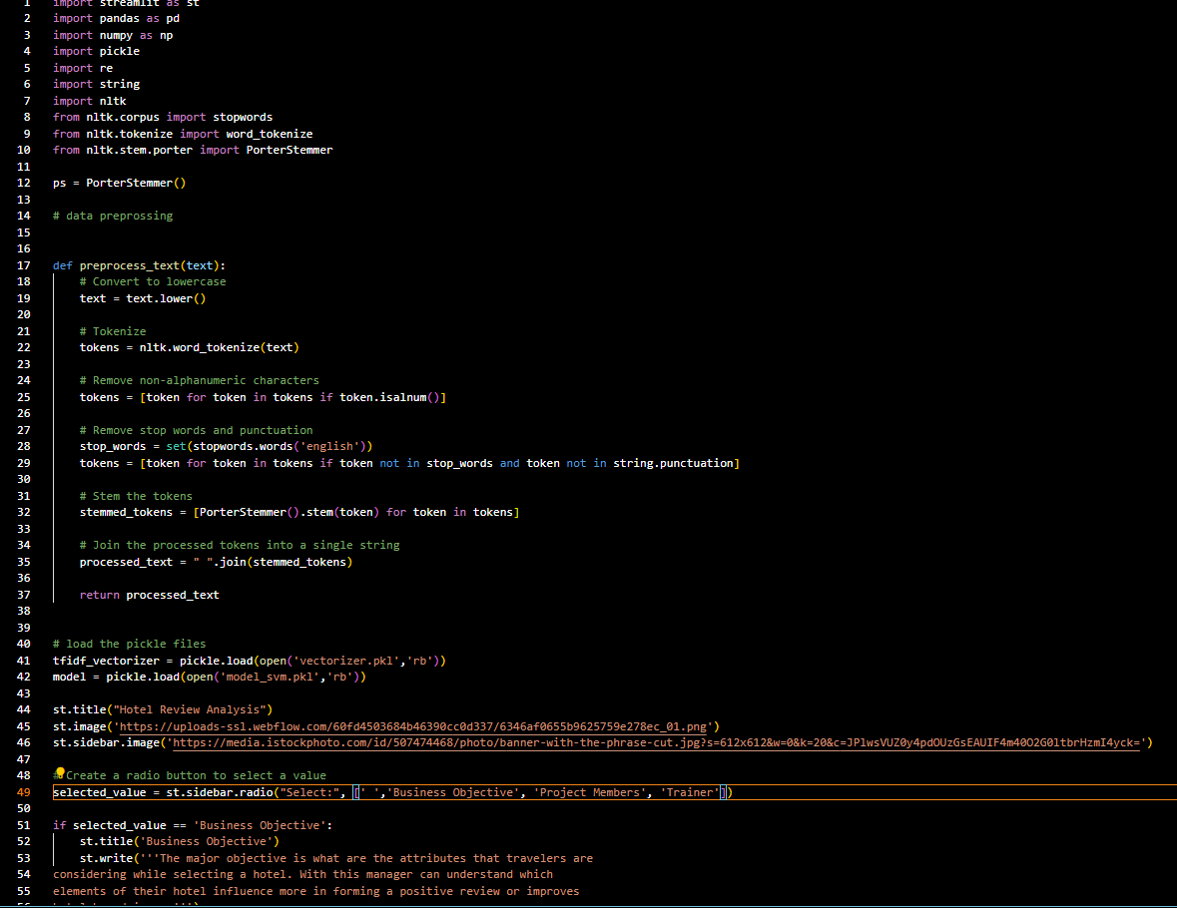
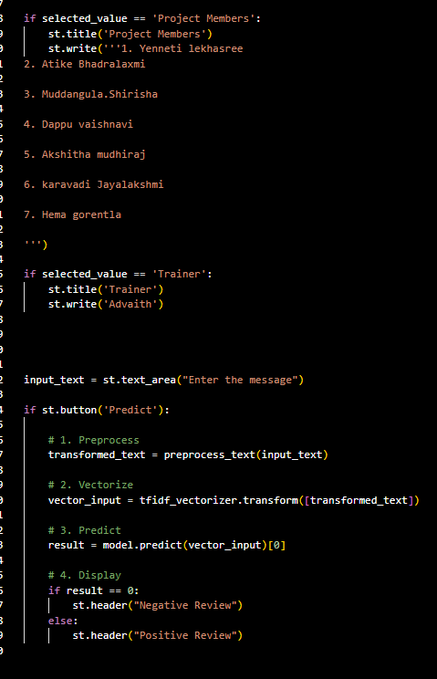
DEPLOYMENT

Slide 23
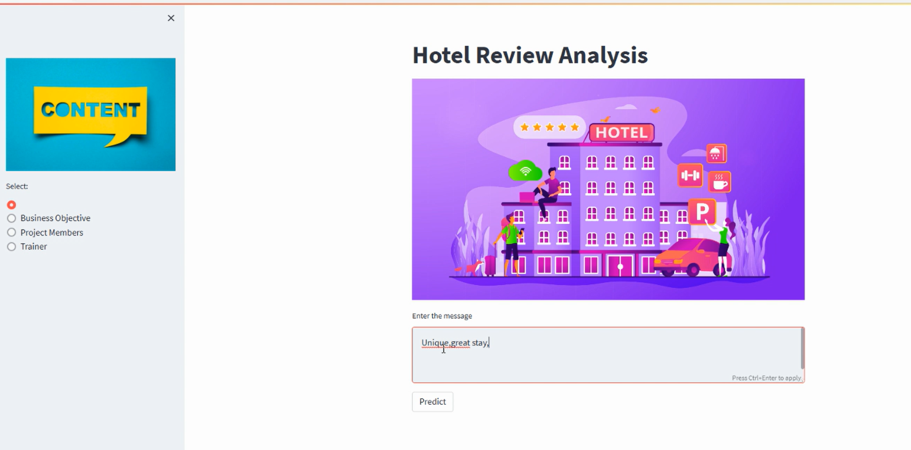
Dashboard:

Slide 24
Problems facing
In many email datasets, the number of Abusive emails is significantly lower than the number of non-Abusive emails. This can lead to biased models that have a high accuracy for the majority class but poor performance for the minority class.
Emails can contain a wide variety of content, from text to images, and can also be written in multiple languages. This can make it challenging to design a single model that can effectively classify all types of emails.
Aveling large email datasets can be time-consuming and expensive, making it difficult to obtain large annotated datasets for training and evaluation.
Due to the high dimensionality of email content, models can easily overfit to the training data, leading to poor generalization performance

Slide 25
Reference
“Text Classification for Sentiment Analysis: A Survey” by Mohammad et al. (2019) - a comprehensive survey of various text classification methods and their applications, including email classification.
"Spam Filter based on Natural Language Processing and Machine Learning" by Al-Shammari et al. (2019) - a study that presents a spam filtering system based on NLP techniques and machine learning algorithms.
"Classifying Email into Spam and Ham using Machine Learning" by Zhang et al. (2017) - a study that compares the performance of several machine learning algorithms for email classification.
"An Effective Email Classification Framework based on Machine Learning Techniques" by Kumar and Namasivayam (2015) - a study that proposes a machine learning-based framework for email classification.

Slide 26
Thank You

